Slide 1

Transport Layer Protocols TCP/IP Protocol Suit
Key function of the Transport Layer Protocols
Introduction to Transport Protocols Similar to TCP
TCP/IP Protocol Suit (part-1)
The Service TCP Provides to Applications
TCP Header Structure
TCP Congestion Control Algorithms
The Internet Protocol (IP) (part-2)
IP Addresses
IP Header Structure

Slide 2
Transport Layer Protocols
OSI Reference Model
The following are some additional features of transport layer protocols:
Across the communication networks, it deals with the flow-control of data between different peers.
It provides the facility of error detecting, error correcting and assurances for free of error transfer of data over the networks.
It guarantees a reliable and efficient data transmission through sending acknowledgements (ACKs) for previously data packets collected.
It manages and handles the network data-flow, if network congestion is encountered; it utilizes effective congestion control mechanisms to maintain its data-rate.
It is responsible for the retransmission of dropped or lost packets during communication.
Application
Presentation
Session
Transport
Network
Data Link
Physical

Slide 3
Transport Protocols Similar to TCP
Protocols Name | Mechanism/Approach | Protocol’s Purpose/Functionality
TCP New Reno | Standard Additive Increase, Multiplicative Decrease (AIMD) Algorithm and Loss-Based Approach | “Standard Transmission Control Protocol (TCP)”
Stream Control Transmission Protocol (SCTP) | Standard AIMD Algorithm and Loss-Based Approach | For message-oriented applications, the core original features of SCTP are multistreaming and multihoming
TCP Vegas | Multiplicative Increase, Multiplicative Decrease (MIMD) Algorithm and Delay-Based Approach | Higher throughput and reduced loss rate
FAST TCP | MIMD Algorithm and Delay-Based Approach | Modified TCP Vegas. Higher throughput with high capacity and large delays
Scalable TCP | Modified AIMD Algorithm and Loss-Based Approach | Great aggressive in Congestion Control. Higher throughput with large delays and high-capacity
BIC-TCP | Modified AIMD Algorithm, binary search technique is combined with additive increase and Loss-Based Approach | A unique window control function is used. Improves the network utilization, and makes it fair with other high speed flows
CUBIC | Modified AIMD Algorithm and Loss-Based Approach | A New TCP-Friendly High-Speed TCP Variant. Higher throughput with high capacity and large delays
High-Speed TCP | Modified High-Speed AIMD Algorithm and Loss-Based Approach | High throughput with high bandwidth and large propagation delays. Adjust TCP response function when cwnd is higher than a threshold value
eXplicit Congestion Control Protocol (XCP) | Similar principle that TCP uses (AIMD) to converge to fairness and Extra Signaling Approach | It uses precise congestion signaling, and fairness control. Higher throughput and faster convergence with high capacity and high delays. Smaller queues.
TCP-XM | AIMD Algorithm and Loss-Based Approach | Extends TCP to allow sender initiated data transfers to n-known hosts, combining native network IP multicast alongside traditional unicast data transmission
Westwood+ | Modified AIMD Algorithm and based on end-to-end bandwidth estimation | Modification of TCP Reno, Proposed for high capacity and large delay networks

Slide 4
TCP/IP Protocol Suit
The TCP/IP suite includes the following protocols:
TCP – Transmission Control Protocol
IPv4 / IPv6 – Internet Protocol

Slide 5
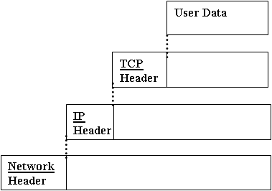
Transmission Control Protocol (TCP)

Slide 6
The Service TCP Provides to Applications
Connection Orientation
Point-To-Point Communication
Complete Reliability
Full Duplex Communication
Stream Interface
Reliable Connection Startup
Graceful Connection Shutdown

Slide 7
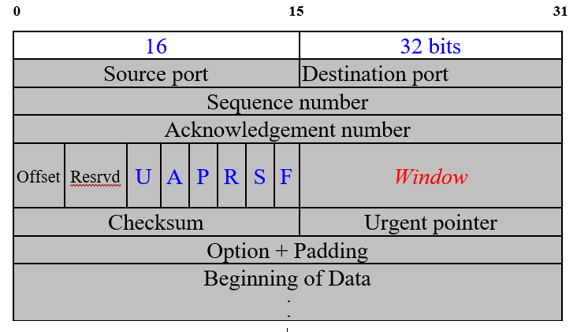
TCP Header Structure
Notes:
Focus ward
F- Sur-paf
Acknowledgment Number (32 bits): If the ACK flag is set, this field contains the sequence number of the next expected data byte from the other end.
Data Offset (4 bits): This field specifies the length of the TCP header.
Reserved (6 bits): These bits are reserved for future use and should be set to zero.
Control Flags (6 bits): TCP uses a number of control flags to manage the connection. These flags include:
URG (Urgent Pointer): Indicates that the Urgent pointer field is significant.
ACK (Acknowledgment): Indicates that the Acknowledgment field is significant.
PSH (Push Function): Instructs the receiver to pass the data to the application as soon as possible.
RST (Reset Connection): Resets the connection.
SYN (Synchronize Sequence Numbers): Used to initiate a connection.
FIN (Finish Connection): Indicates the sender has finished sending data.
Window Size (16 bits): This field specifies the size of the receive window
Checksum (16 bits): This field is used for error checking.
Options (variable length): This field is optional and may or may not be present.
Padding (variable length): If the Options field causes the header length to be uneven, padding is added to make the header a multiple of 32 bits.

Slide 8
Definitions
Segment
Sender Maximum Segment Size (SMSS)
Receiver Maximum Segment Size (RMSS)
Receiver Window (RWND)
Congestion Window (CWND)
Loss Window (LW)
Restart Window (RW)

Slide 9
TCP Window Principle

Slide 10
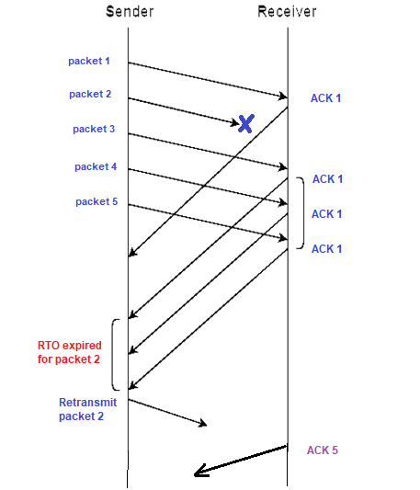
TCP Window Principle
Imagine some special cases:
Packet 2 gets lost
sender will not receive ACK 2, window will remain in position 1
receiver did not receive packet 2, it will acknowledge packets 3, 4, and 5 with an ACK 1
timeout will occur for packet 2 and it will be retransmitted, receiver will generate ACK 5
successfully received all packets 1 to 5, sender's window will slide four positions upon receiving this ACK 5
Packet 2 did arrive, but the acknowledgment gets lost
sender does not receive ACK 2, but will receive ACK 3
ACK 3 is an acknowledgment for all packets up to 3 (including packet 2)
sender can now slide its window to packet 4

Slide 11
TCP Congestion Control Mechanism
Slow Start and Congestion Avoidance
Fast Retransmit/Fast Recovery

Slide 12
Slow Start and Congestion Avoidance
TCP Slow Start
TCP Slow Start & Congestion Avoidance

Slide 13
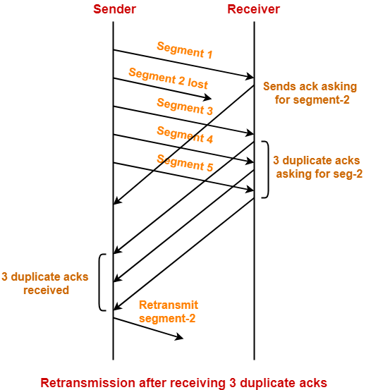
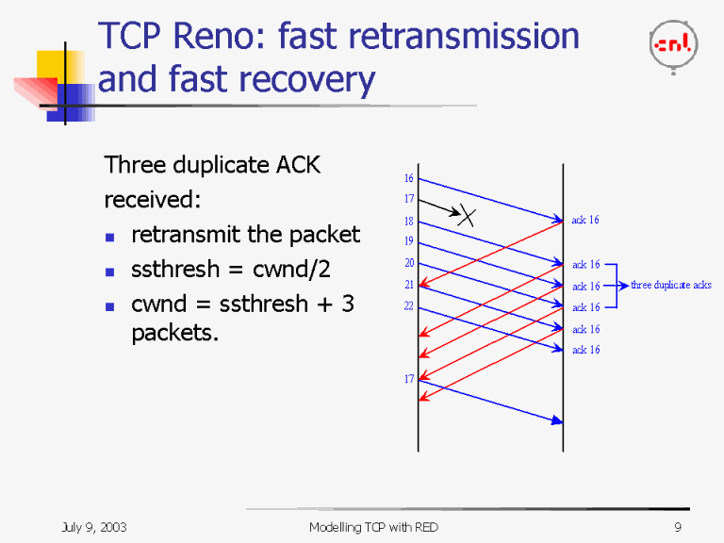
Fast Retransmit/Fast Recovery
Notes:
The sequence of steps taking place are as:
On receiving the first TCP segment-1, receiver sends an acknowledgement asking for second TCP segment-2.
On receiving the third TCP segment-3, receiver sends acknowledgement asking for second TCP segment-2 next.
On receiving fourth TCP segment-4, receiver sends acknowledgement asking for second TCP segment-2 next.
On receiving fifth TCP segment-5, receiver sends acknowledgement again asking for second TCP segment-2.

Slide 14
TCP Congestion Control Algorithms

Slide 15
Thank You
Q & A

